Slide 1
IMDB-Sentiment Analysis of 2022 Movies based on User-Reviews
ENSF-612 Course Project
Presentation 2
Samuel Sofela
Sam Rainbow
Christopher DiMattia
March 26nd, 2022

Slide 2
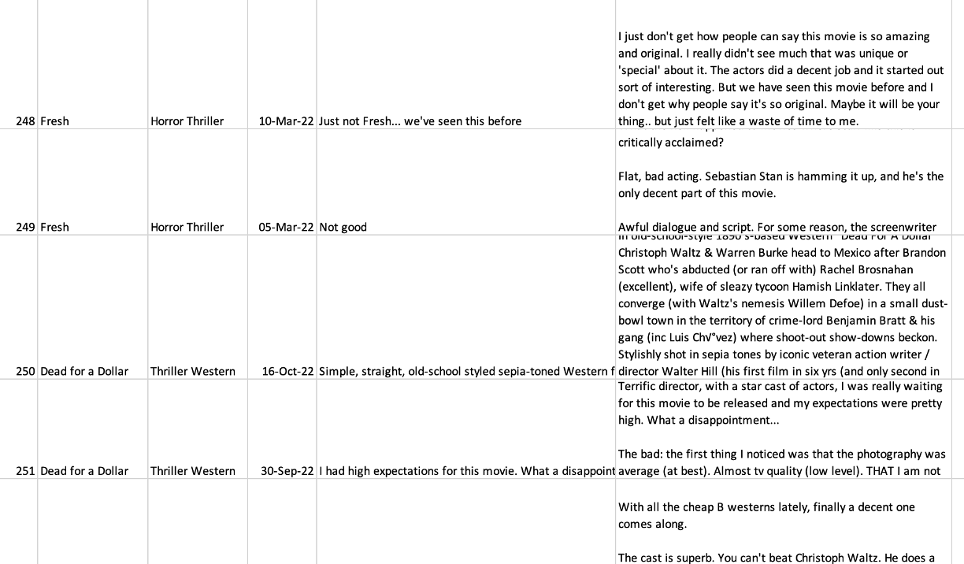
Data Collection
Data collected through web scraping using BeautifulSoup library.
25 reviews/movie for 40 movies collected (1000 reviews)
Most helpful reviews were used to avoid troll reviews
Target variable is combination of Review Title and Review Content
Review Title
Review

Slide 3
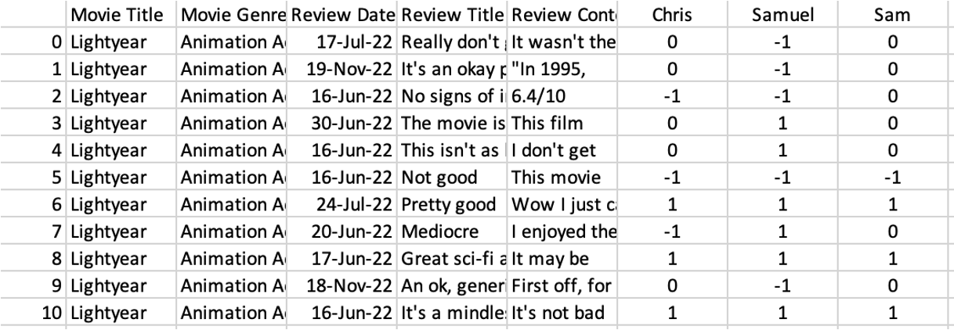
Quality of Data Labeling
All reviews were labelled into 3 sentiments: positive(1), neutral (0) and negative(-1)
Each member labelled 1000 reviews.
2 metrics used to evaluate quality of labelling
•Percentage Agreement
•Cohen-Kappa

Slide 4
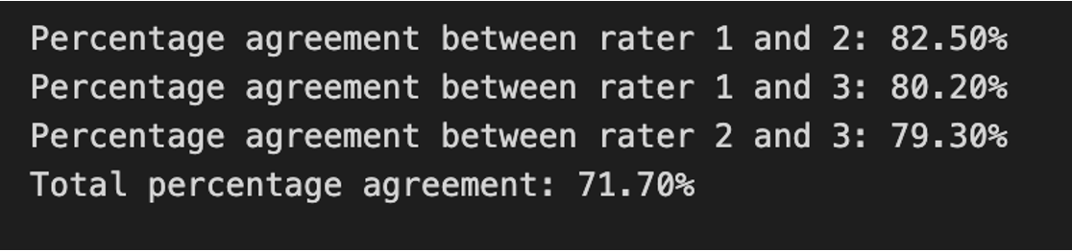
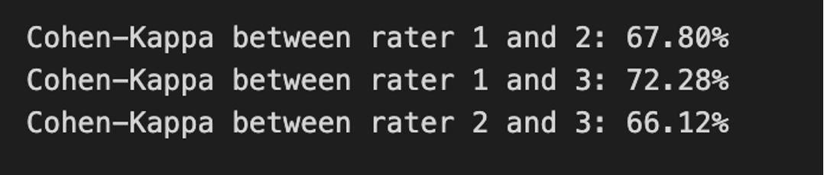
Quality of Data Labeling
Percentage Agreement
Cohen-Kappa

Slide 5
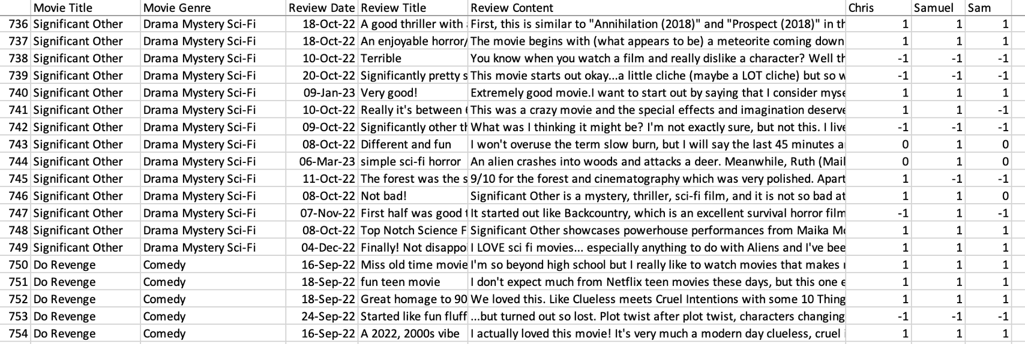
Quality of Data Labeling: Disagreement Resolution
•2 or more similar rating.
•The rating with the highest count used as final review rating.
2 Similar
Rating
3 Similar
Rating

Slide 6
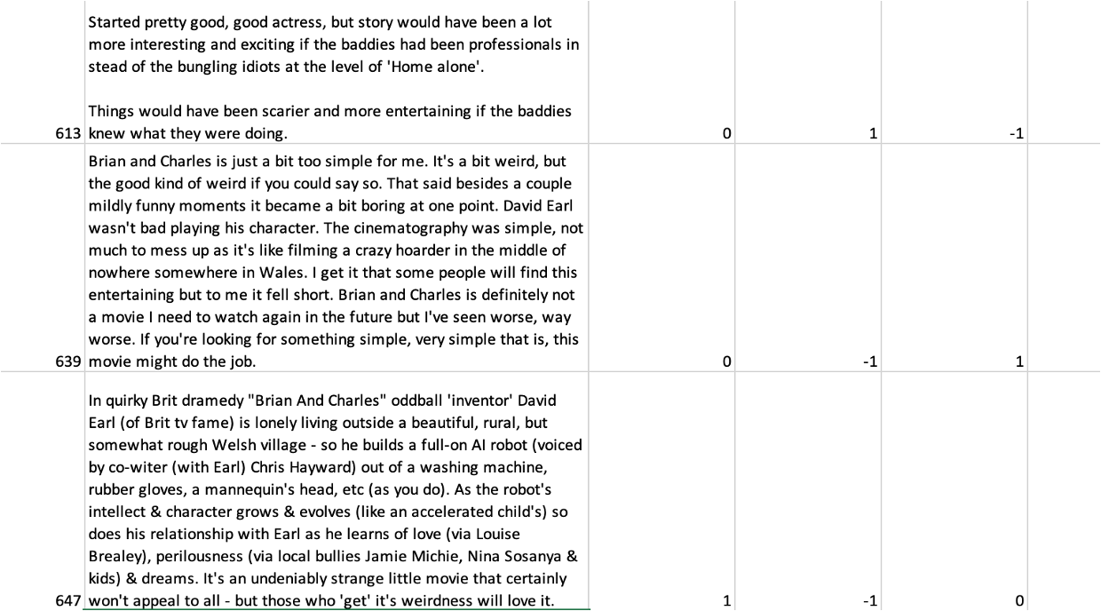
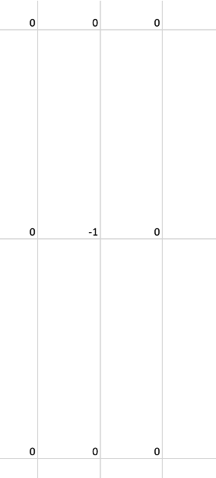
Quality of Data Labeling: Disagreement Resolution
3 different ratings
14 instances found
Reviews were collectively revisited and rated
Disagreement
Resolution

Slide 7
Quality of Data Pre-processing
Raw Data
Reviewer Comment
“I was able to see this mo\svie in theatres and I enjoyed it so much. Watching movies from this time period helps me to realize how blessed we are to be living in 2022!”
Reviewer Comment Title
“Very well done!”
Combine Comment and Title
“Very well done! I was able to see this mo\svie in theatres and I enjoyed it so much. Watching movies from this time period helps me to realize how blessed we are to be living in 2022!”
Clean Text
Remove non-alphabet characters and spaces and transform to lowercase
“very well done I was able to see this movie in theatres and I enjoyed it so much watching movies from this time period helps me to realize how blessed we are to be living in”

Slide 8
Quality of Data Pre-processing
Remove stop words
Nltk corpus stopwords (“english”)
“well done able see movie theatres enjoyed much watching movies time period help realize blessed living”
Lemmatization and tokenized
Using Wordnet POS
“["well", "do", "able", "see", "movie", "theatre", "enjoy", "much", "watch", "movie", "time", "period", "help", "realize", "blessed, live"]

Slide 9
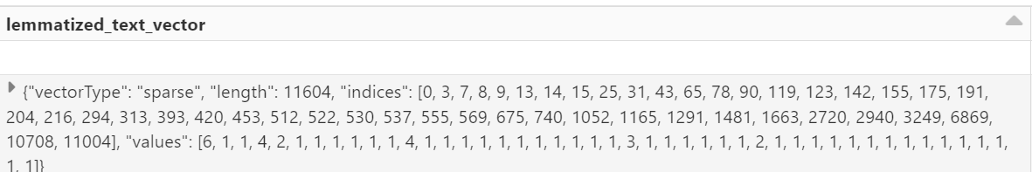
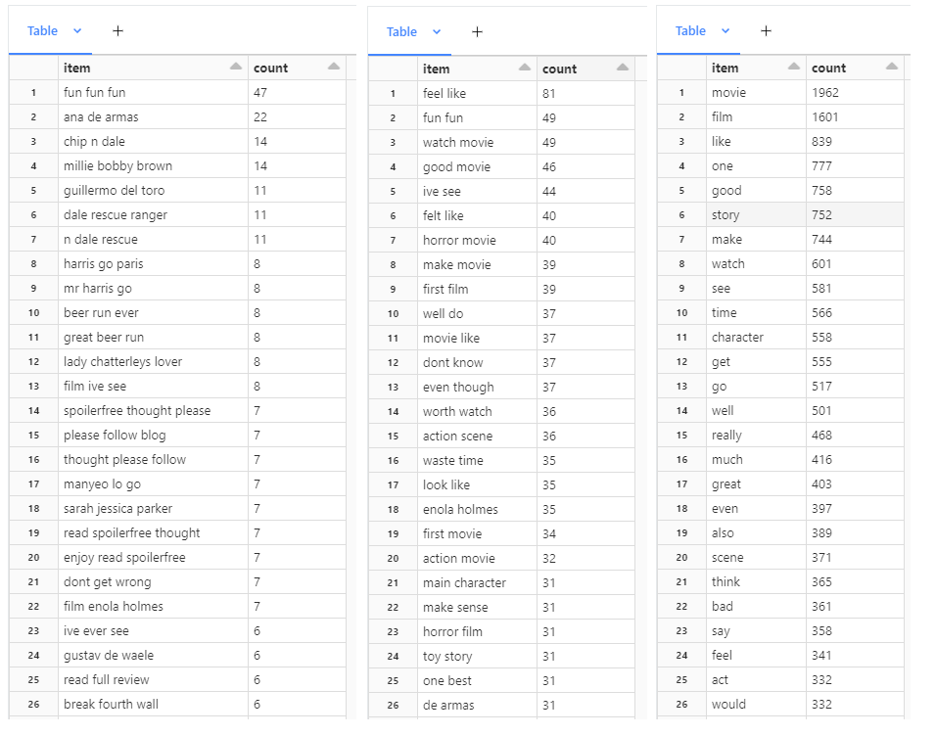
Features & Feature Analysis
Input vectors
Lemmatized text
Bag of Words
Bi-grams
TF - IDF
Genre
Month of review
Features are analyzed, then vectorized
CountVectorizer for:
Bag of Words
Bi-grams
TF - IDF
OneHotEncoder to vectorize categorical features:
Genre
Month of review
Features are then fed into ML model

Slide 10
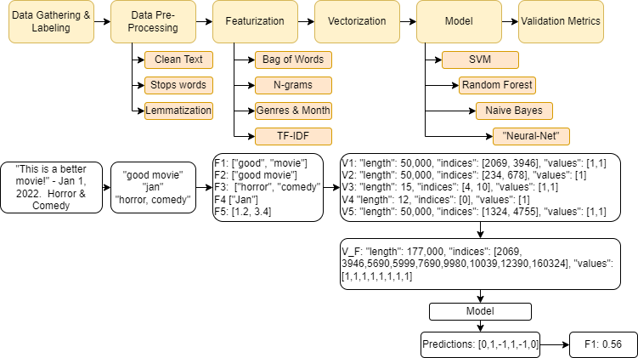
Overview of Machine Learning Model

Slide 11
Machine Learning
Selected Machine Learning Models
SVM
Works well on high dimensional data (many features)
Works well for complex decision boundaries
Random Forest
Fast to run and less sensitive to scaling
Features are processed separately so scaling is not a major concern
Better than decision trees
Naive Bayes
Fast to train
Works well on high dimensional data (many features)
“Neural Net”
Powerful and accurate
Low Priority Models
Logistic Regression
Data is not linearly separable
K-NN
Computationally difficult
Decision trees
Can overfit data and is weaker than random forest

Slide 12

Questions?

